Slide 1
How Abnormal Temperatures Affect Climate Change Attitudes and Behaviors
Kris Nichols

Slide 2
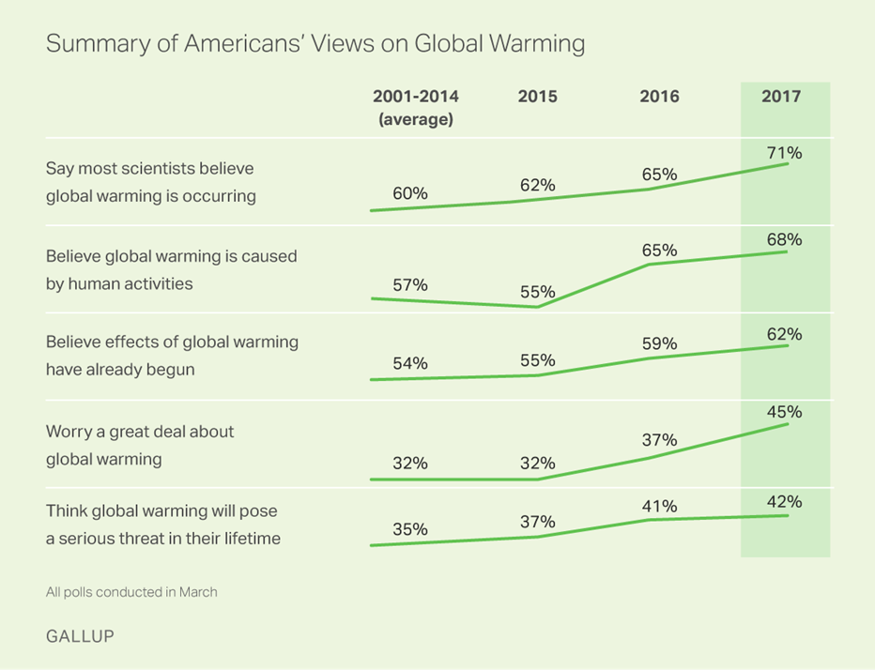
The Threat of Climate Change
Polls indicate that Americans are increasingly concerned about climate change.
Global warming will harm: them (the survey taker) personally (42%), people in the U.S. (56%), people in developing countries (61%), and future generations (70%).
Why is there a disconnect between the personal danger a person feels from climate change and the existential danger of climate change?

Slide 3
Perceived Low Risk of Personal Harm
Research has indicated a number of potential cognitive biases that may be contributing to this such as: skepticism in science, an identity protection mechanism, framing effects, and cognitive dissonance.
Research indeed indicates that when surveys were administered during periods in which temperatures were abnormally hot or cold that participants were more concerned about climate change.
Notes:
Majorities of Americans say global warming is a major environmental (69%), scientific (62%), or agricultural issue (56%). About half consider it a major health (49%) or economic issue (47%). Worry about macro presence of effects present, not present in micro scenarios.
Less worry about anything catastrophic happening in their lifetimes

Slide 4
Cognitive Biases and Climate Change Attitudes
Recently, researchers have begun to investigate how individuals climate change attitudes may fluctuate in accordance with more abnormal behaviors.
Research indeed indicates that when surveys were administered during periods in which temperatures were abnormally hot or cold that participants were more concerned about climate change.

Slide 5
Potential Problems in the Literature
Methodological:
Non-response bias in national survey
Lack of precision in instruments
Observer-expectancy bias
Content
What does concern really indicate?
Particularly in the face of proposed identity-protection mechanisms
Lack of insight into mechanisms
Introduces schism between behavior and attitudes.
Is a person who answers “Not Concerned” on a survey, but googles “climate change debunked” shortly after taking it really not concerned?

Slide 6
Proposed Project
Investigate how abnormal temperatures affect number of Google searches for climate change cross Democratic, Republican, and swing states may alter climate change behavior as measured by Google search data.
Allow for greater clarity as to potential mechanisms
Allow for comparison between conservative and liberal states
Allow for greater ability to interpret concern.
Element of Randomization

Slide 7
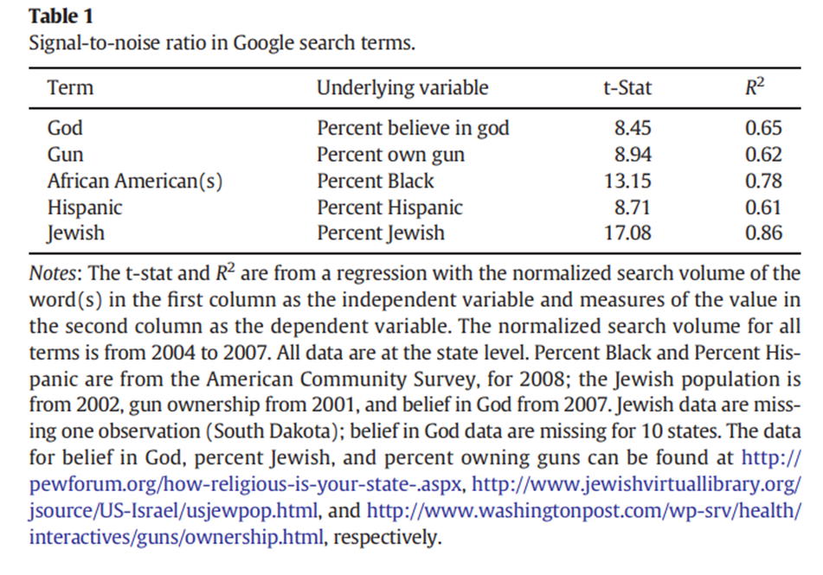
Google Search Data
Arguably, Google search data at its best is data that represents true, unaltered behavior and motivation. If someone is concerned about climate change we should see higher activity for climate change Google searches. Furthermore, if someone is Googling “climate change not real” as a way to self-soothe this should also show up.

Slide 8
Data

Slide 9
Proposed Models

Slide 10
Hypotheses
Predict that regardless of political party, that states with high temperature discrepancies will have significantly more general Google searches regarding climate change and global warming.
Furthermore, I predict that when Google searches for “climate change not real” or “global warming not real” are included in analyses that these data will control for the majority of variation in Republican states.
This study will suggest both an identity-protective mechanism by which participants initially Google “climate change not real” and a cognitive dissonance mechanism which alters their behaviors.

